Slide 1
COESC AI+AR/VR Day 1 Tutorial
Spring 2025
Luke Miller

Slide 2
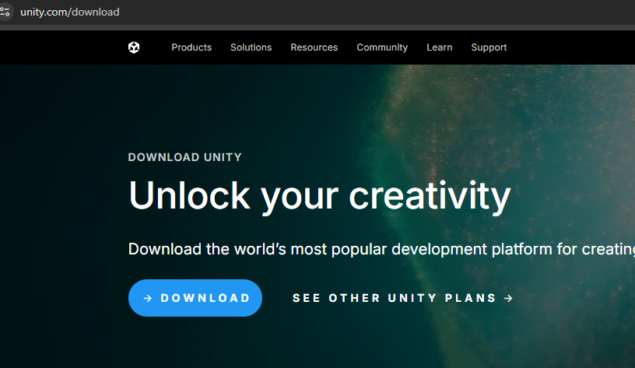
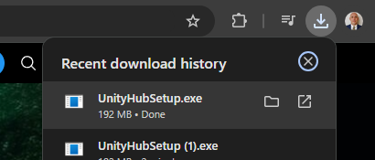
Install UnityHub
(Not for COESC Computers)
Included for your reference - Unity already installed for this course.
Go to https://unity.com/download
Click Download
Run UnityHubSetup.exe
If necessary, allow access. Agree to terms, and Install

Slide 3
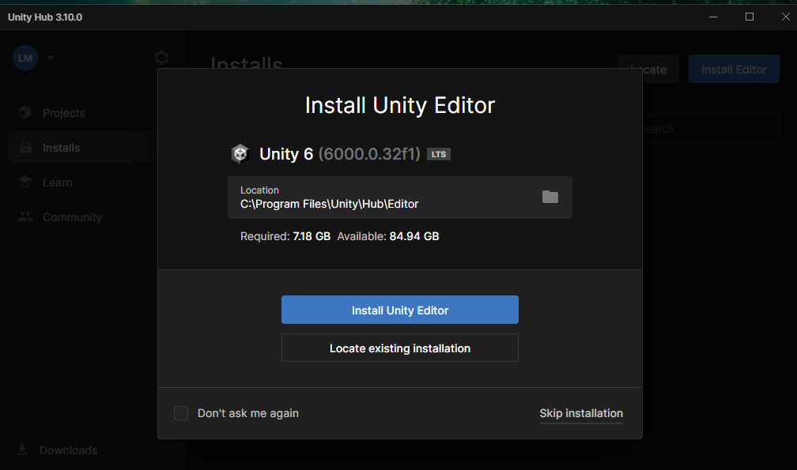
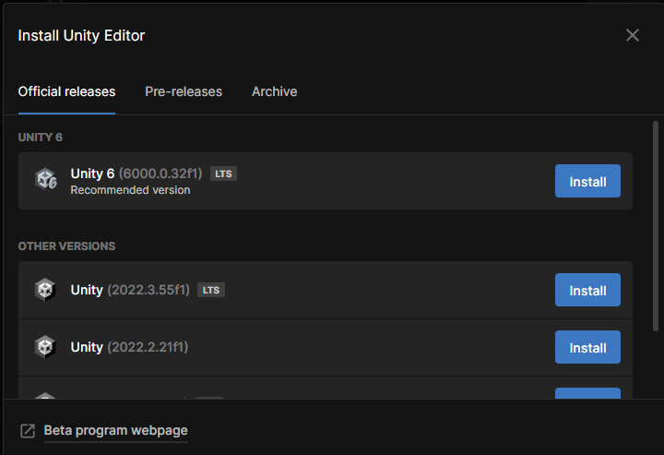
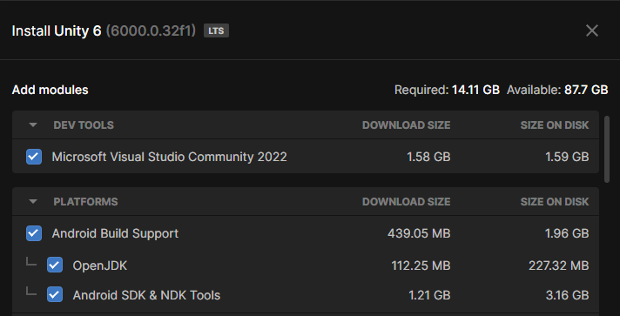
Install Unity Editor
(Not for COESC Computers)
Launch Unity Hub - It should prompt you to install Unity Editor
Add Android Build Support - If you already have Unity Installed, we will include instruction on how to add this later.
Agree to terms and install

Slide 4
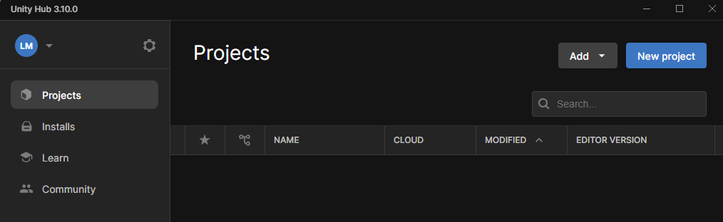
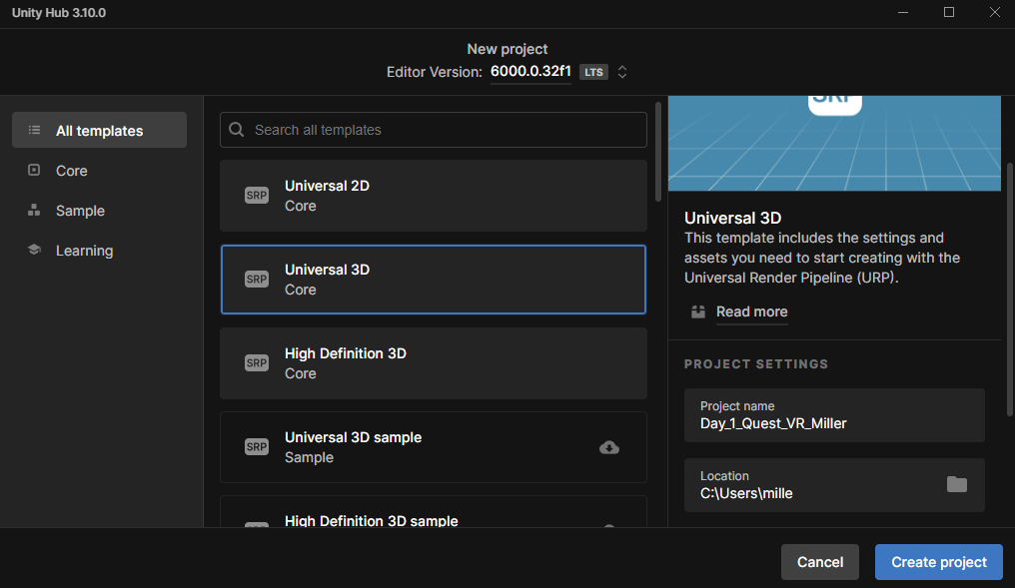
Create a New Project
Click "New project"
Click "Universal 3D"
Give your project a name
Click "Create project
Unity Editor should Launch

Slide 5
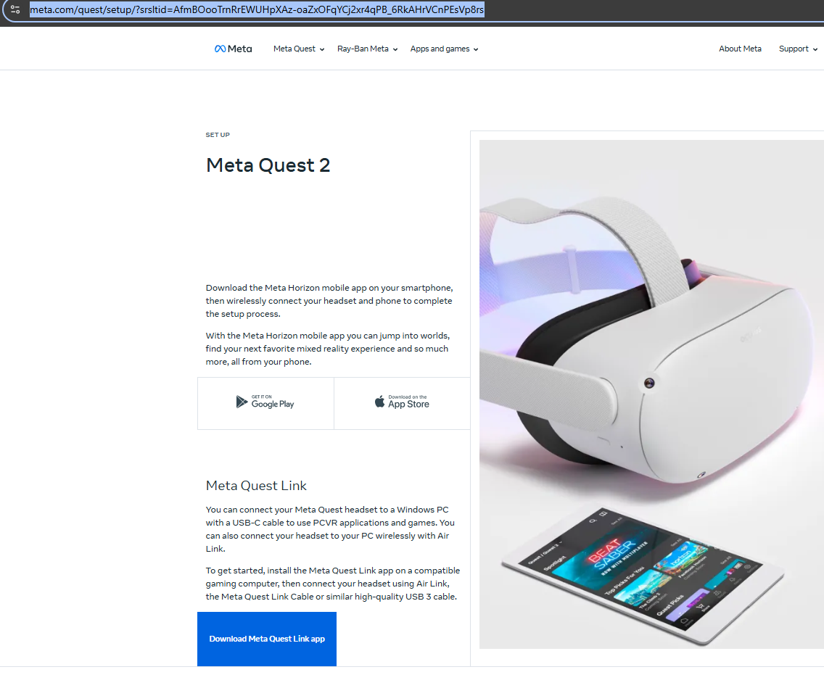
Install Oculus Link
(Not for COESC Computers)
Go to the Meta Website and download the Oculus Link App.
Run OculusSetup.exe from the downloads folder.
Click "Get Started", "Agree", "Install Now"
If necessary, create a Meta account, otherwise, login.
While here sign up as a Meta Quest Developer

Slide 6
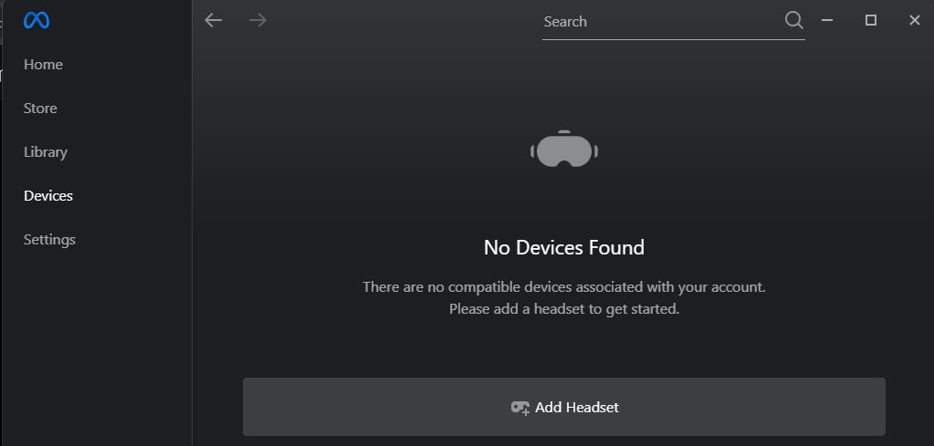
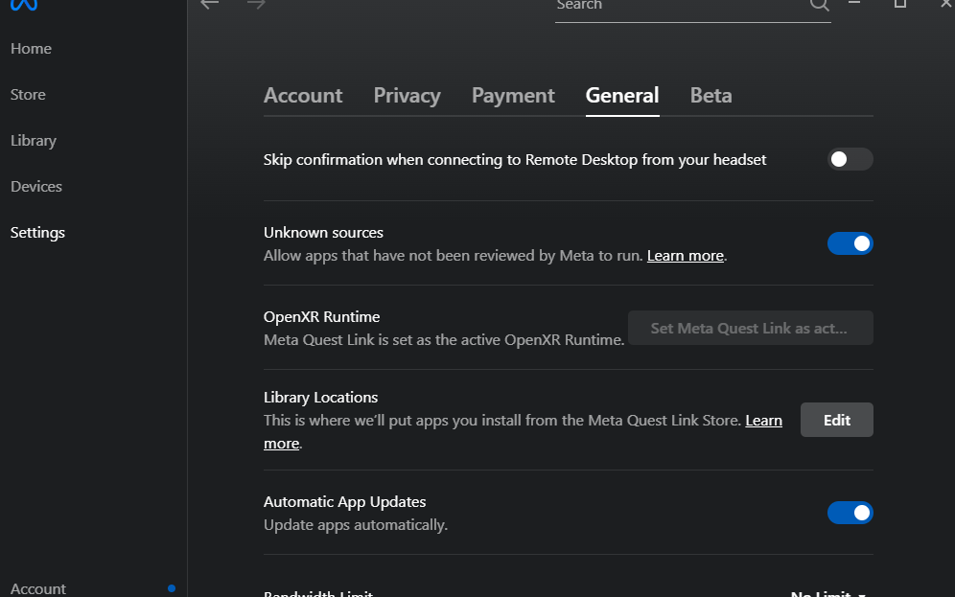
Add Headset to Oculus Link
Power on headset and connect it to the computer with the Link Cable (you need very good WiFi for AirLink, not recommended)
Select "Devices", "Add Headset"
Select Settings, General
Set Meta Quest as OpenXR Runtime

Slide 7
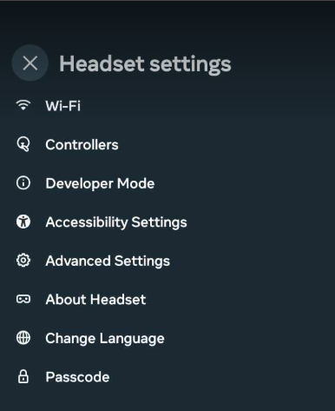
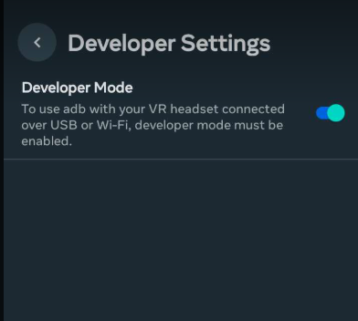
Enable Developer Mode on Mobile App
(Not for COESC Headsets)
Open the Mobile App associated with the headset
Open Headset settings
Select Developer Mode
Enable

Slide 8
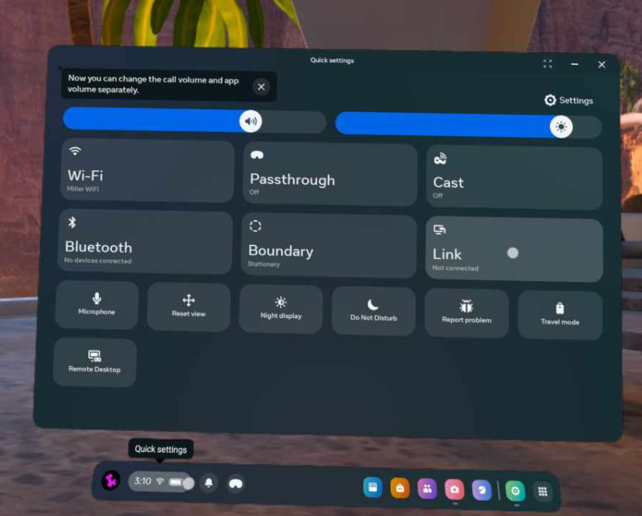
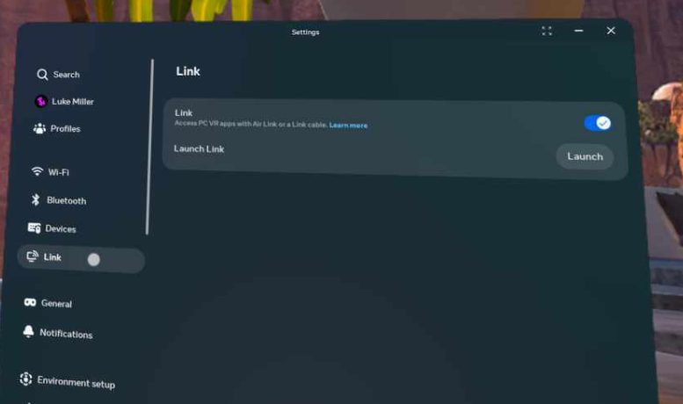
Ensure Link is Enabled
on Headset
Open Quick Settings
Select Settings
Select Link
Enable

Slide 9
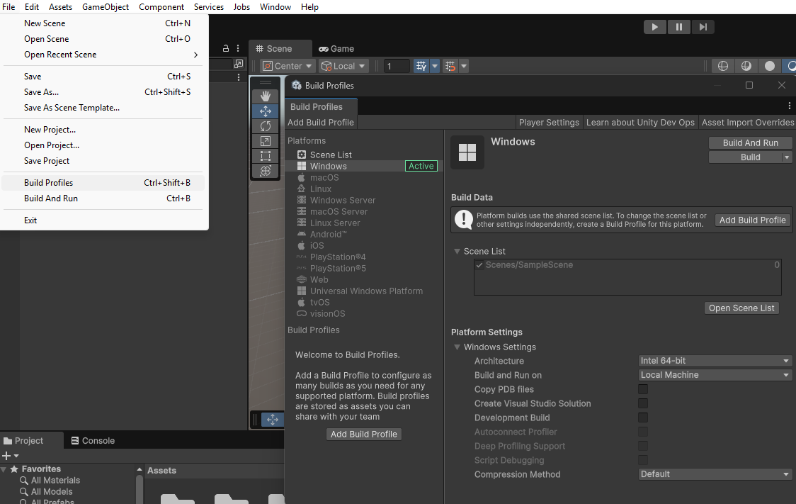
Ensure Android Modules are Installed
In Unity Editor:
Select File
Build Profiles
Ensure Android is selectable
If not, install Android Build Support (Next Slide)

Slide 10
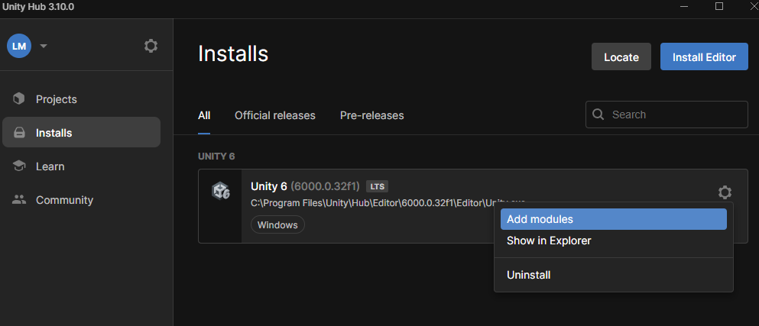
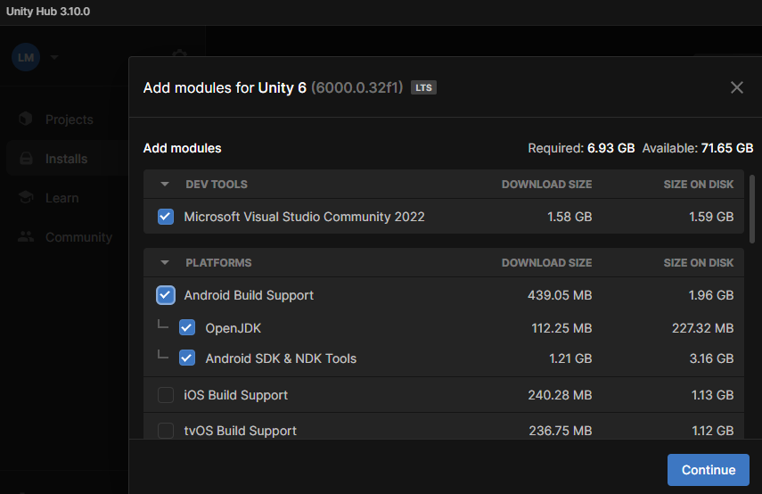
Adding Android Modules to Unity Editor
(Not for COESC Computers)
In Unity Hub:
Select Installs
Click the Gear Icon
Select "Add Modules
Select "Android Build Support"
Continue
Agree to terms and Install

Slide 11
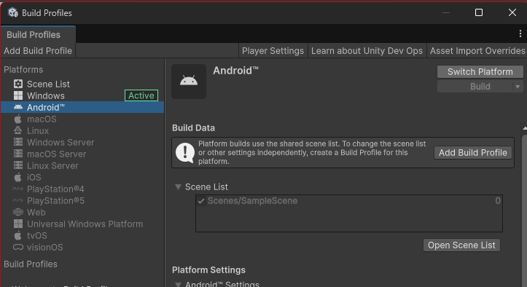
Switch Platform to Android
In Build Profiles:
Android
Switch Platform

Slide 12
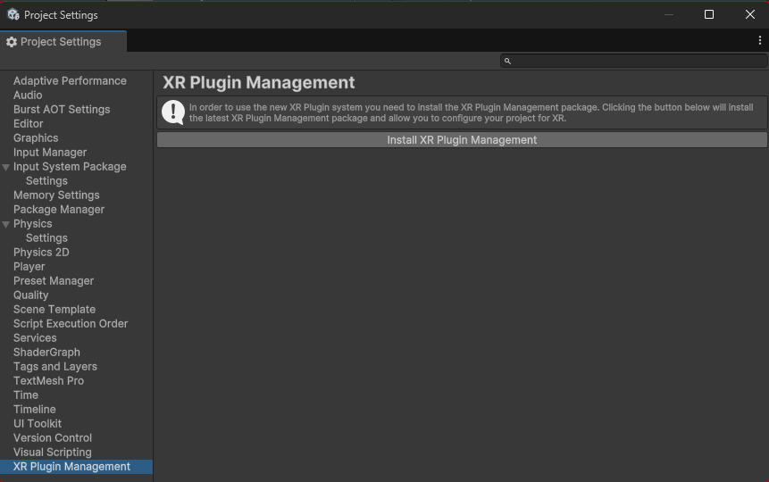
Install XR Plugin Management
In Build Profiles:
Select Player Settings
In Player Settings:
Scroll down and select XR Plugin Management
Select Install

Slide 13
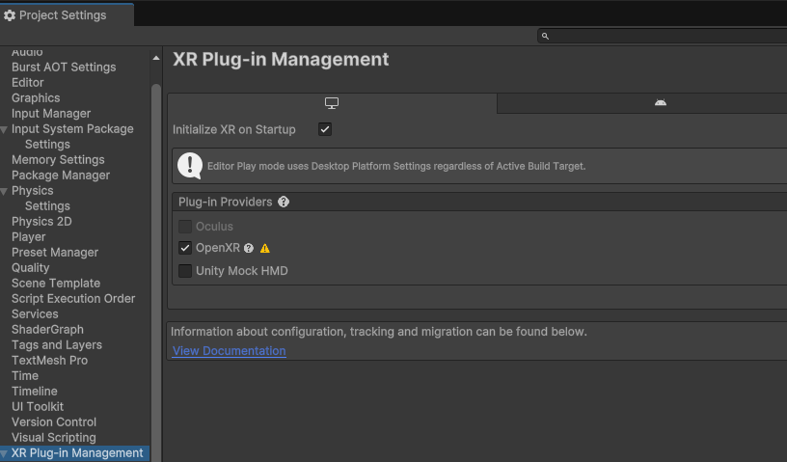
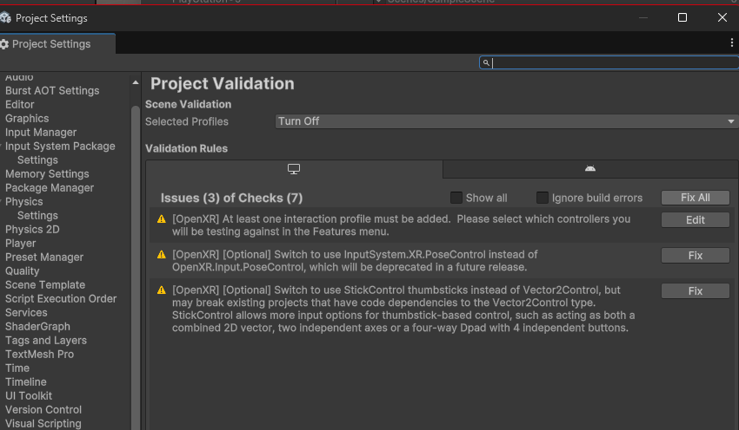
Configure XR
Select PC tab
Select Open XR - Unity will install
After Installation, select warning.
In the new, Project Validation Window, Select Fix All

Slide 14
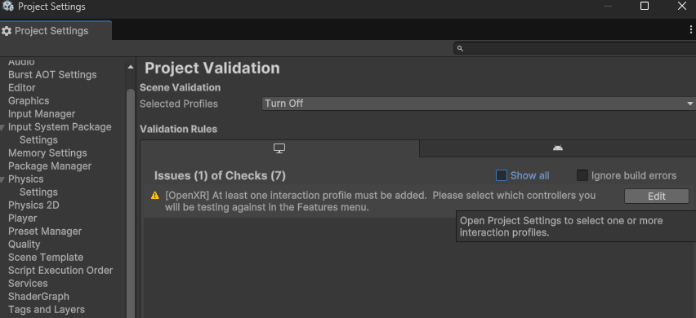
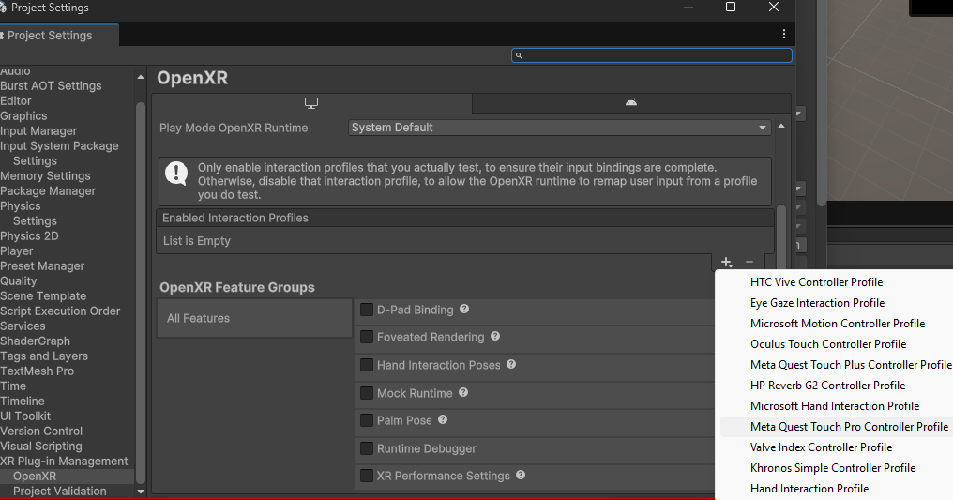
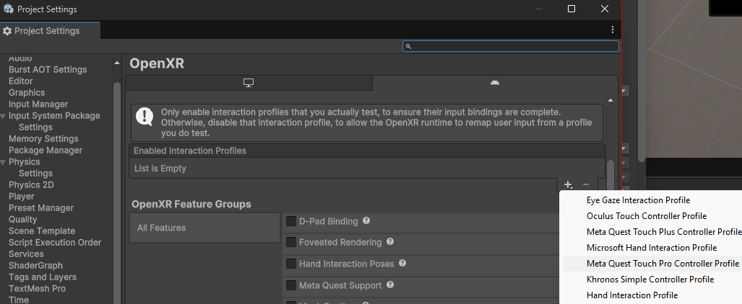
Add Interaction Profile
You will still have to add an an interaction profile, select edit
In the new Window, Click the Plus under the Interaction Profiles
Select the "Meta Quest Pro Touch Controller Profile
Select the Android Tab
add the Meta Quest Pro Touch Controller Profile
Select Meta Quest Support

Slide 15
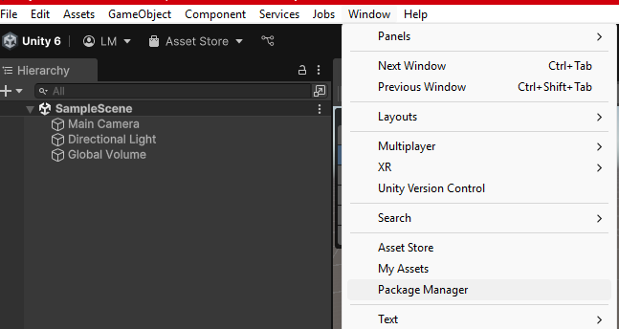
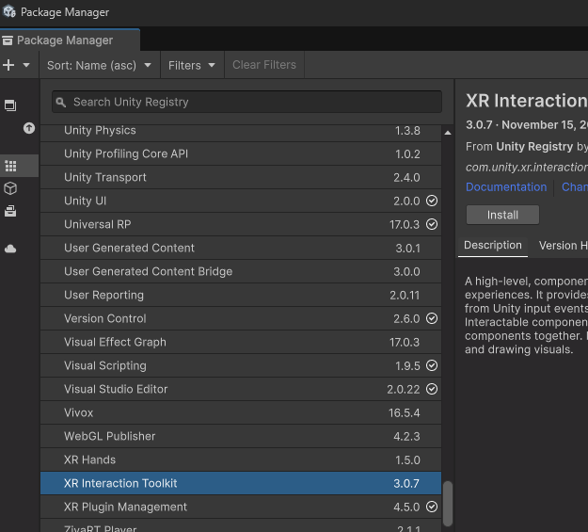
Install XR Interaction Toolkit
Select Window
Select Package Manager
Select Unity Registry
Scroll down and select XR Interaction Toolkit
Install

Slide 16
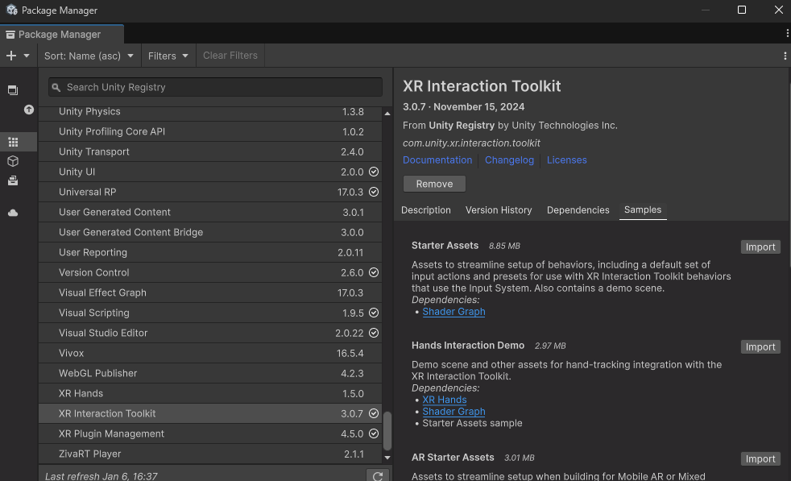
Import XR Samples
In the same Window
Select Samples
Import Starter Assets
XR Device Simulator is also useful, but not required here

Slide 17
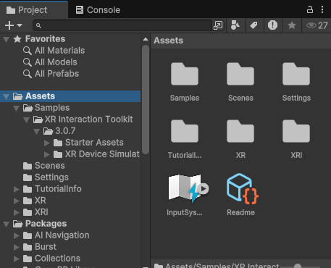
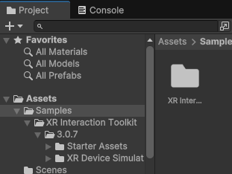
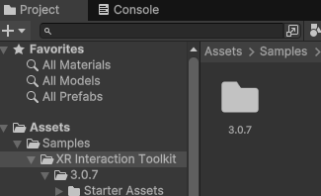
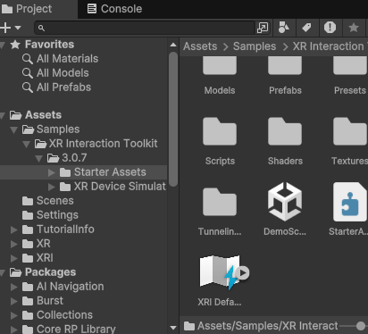
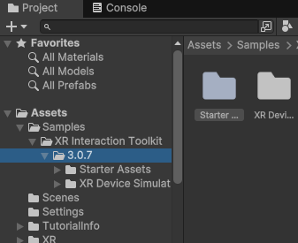
Create the Demo Scene
On the main page of the Unity Editor, in the Projects Window, select Assets, then Samples
Select XR Interaction Toolkit
Select 3.0.7 (or something similar)
Select Starter Assets
Double click Demo Scene

Slide 18
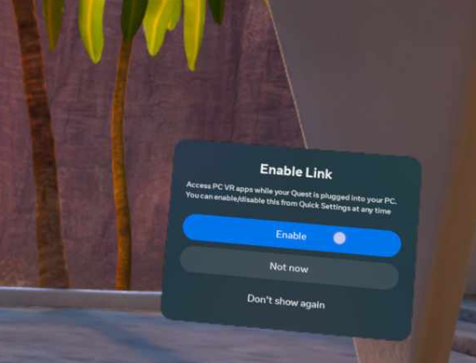
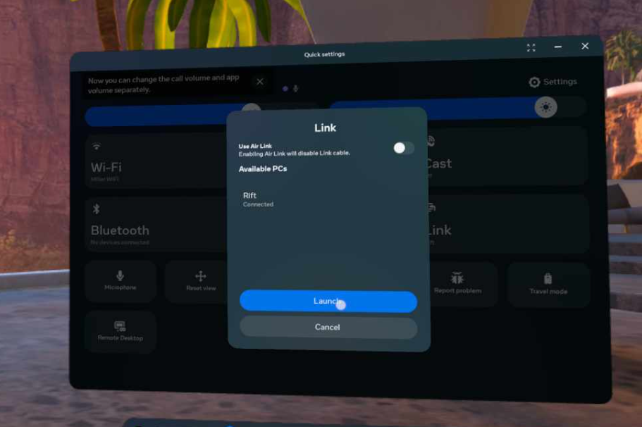
Turn on Link
on Headset
Click on Quick Settings
Select Link
Click Enable
Launch

Slide 19
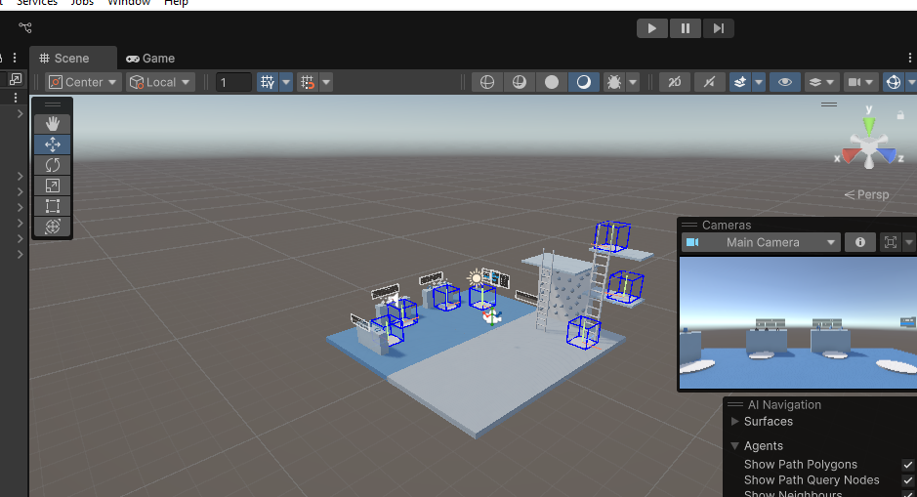
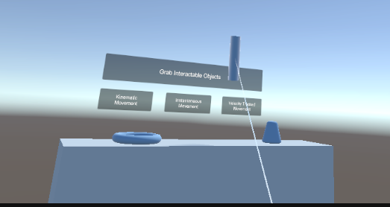
Test Scene
Peek under headset and press play to text the scene.
Text out the scene, interact with objects, have fun.
Press Stop in Unity when done

Slide 20
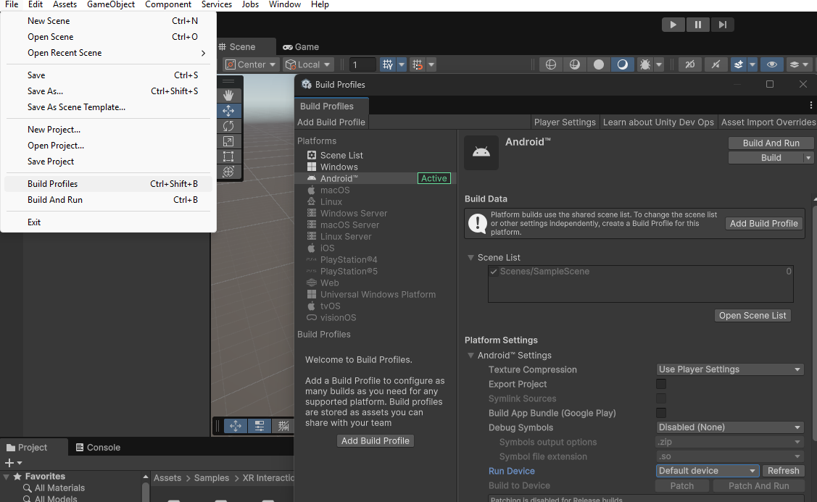
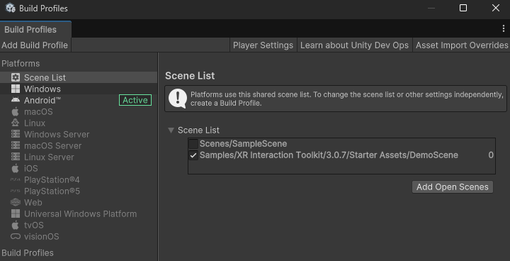
Setup for Deployment
In Unity, Select File, Build Profiles
Ensure Android is Active
Select Default Device, and change to Oculus
Select Open Scene List
Deselect the Sample Scene Unity started us with
Select the Demo Scene we added
Select Player Settings
Under Other Settings, Scroll Down to "Minimum API Level", Select API Level 29

Slide 21
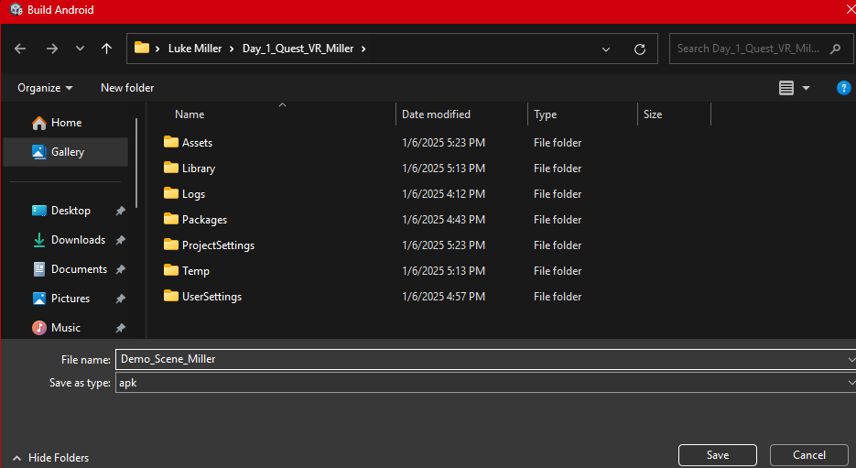
Setup for Deployment
Select Android
Click Build and Run
Name the Build and save
If you get an error about input handling, just click yes to ignore
After building, It should automatically run. Test it and exit.

Slide 22
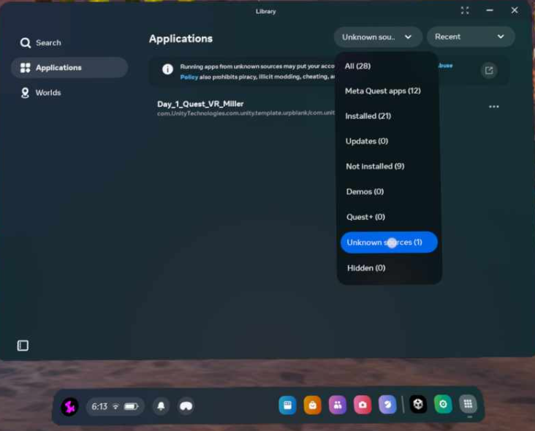
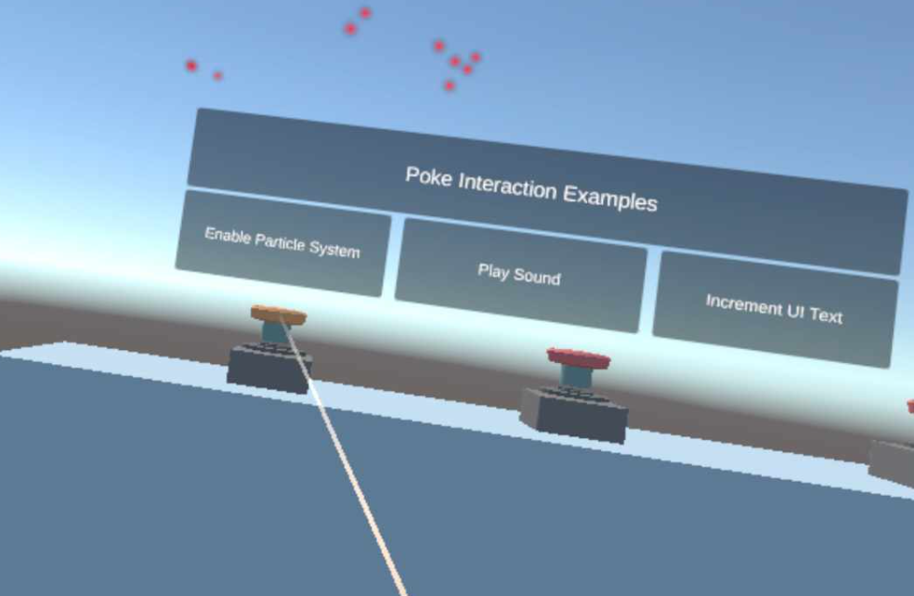
Test while Link disconnected
Game will likely be in task bar
If not:
Open your Applications
Select Source,
Select Unknown
Open App
Test the App

